Slide 1
Paddy Disease Classification
Presenter : Jennis (Chingtzu) Huang
2022 August

Slide 2
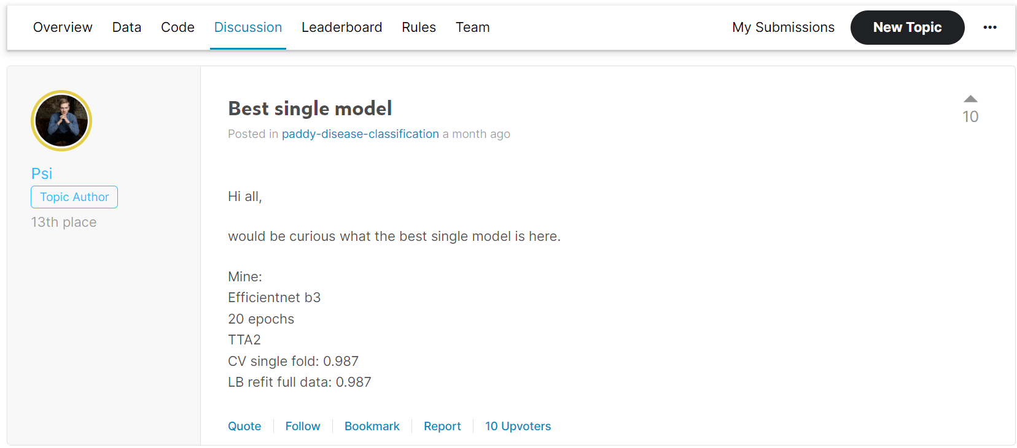
Competition Discussion
According to the discussion ”Best single model”, Efficienet b3 has 0.987 accuracy.

Slide 3
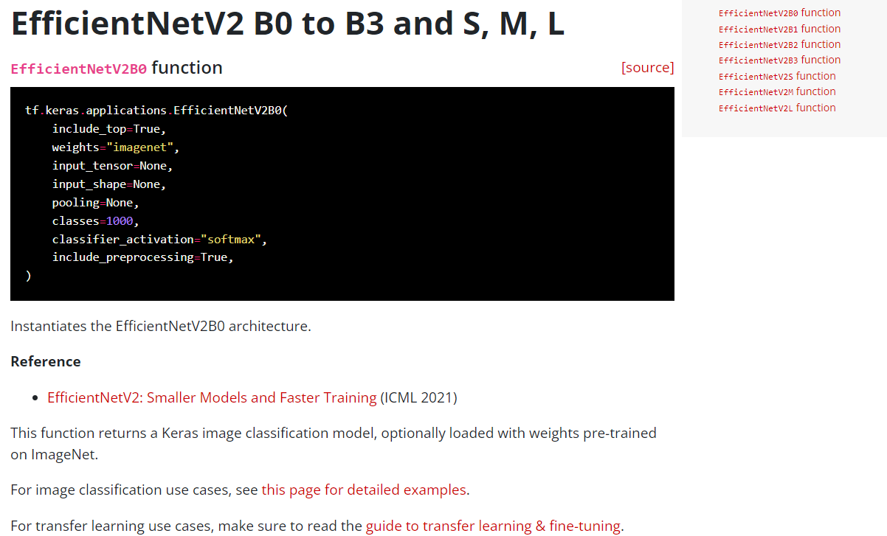
Method1-Keras image classification model

Slide 4
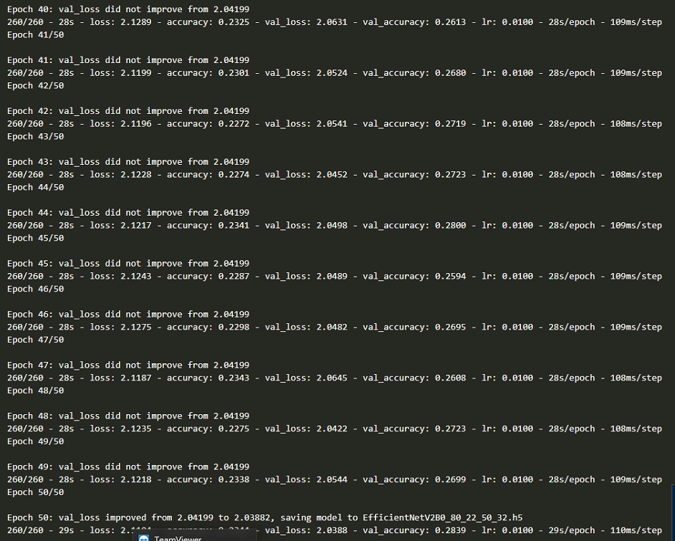
EfficientNetV2B0 50 epochs 32 batch size
Training history

Slide 5
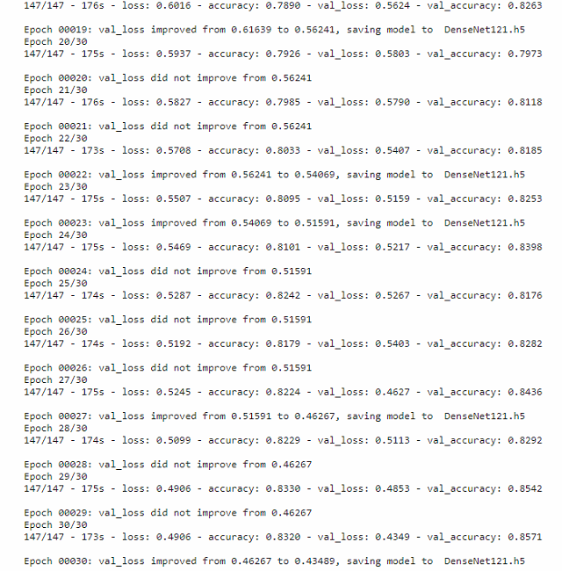
DenseNet121 30 epochs 32 batch size
Training history

Slide 6
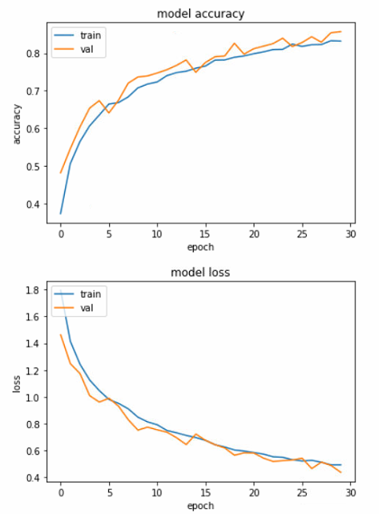
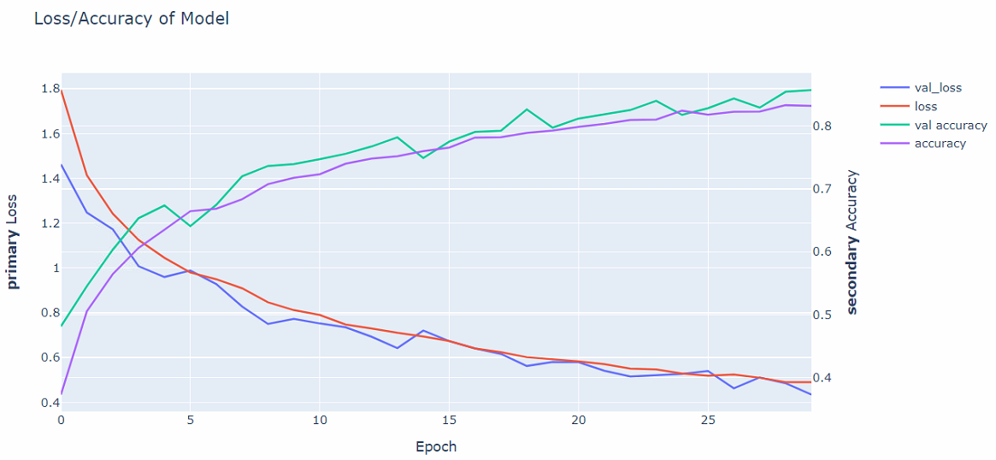

Slide 7
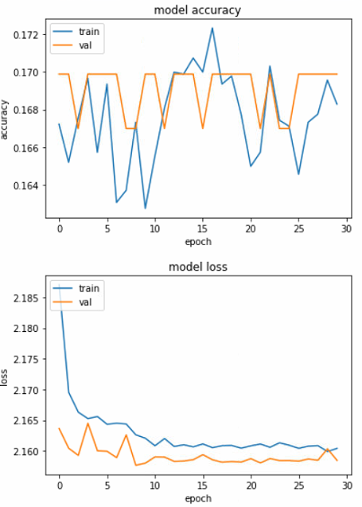
EfficientNetB3 30 epochs batch size 64

Slide 8
Method2-Fastai(python library)
fastai is a deep learning library which provides practitioners with high-level components that can quickly and easily provide state-of-the-art results in standard deep learning domains, and provides researchers with low-level components that can be mixed and matched to build new approaches
Environment using Kaggle notebook(online GPU)
https://docs.fast.ai/

Slide 9
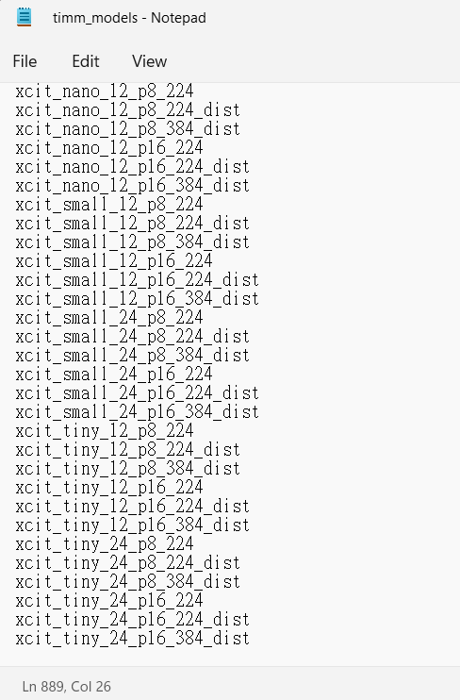
Pretrained Timm models
889 pretrained model can be used

Slide 10
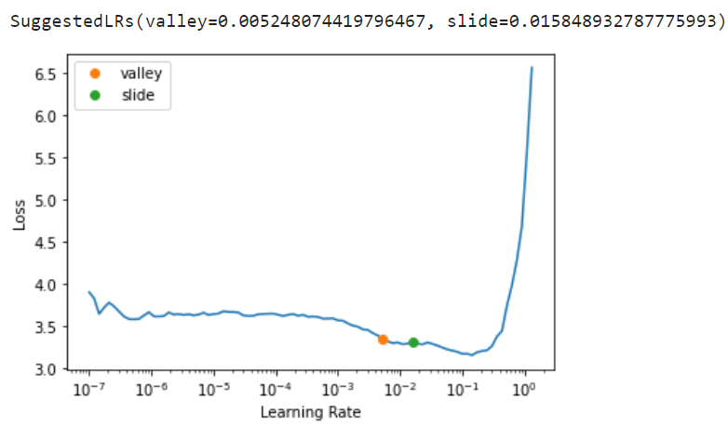
Fast ai powerful function – find learning rate
Example: efficientnet_b3 model suggested learning rate ≒0.01

Slide 11
Model | epochs | Input size | Public score
convnext_base_in22k | 40 | 224x224 | 0.98769
convnext_small_in22k | 100 | 128x128 | 0.98692
convnext_base_in22k | 100 | 224x224 | 0.98615
convnext_base_384_in22ft1k | 20 | 384x384 | 0.98385
convnext_small_in22k | 20 | 128x128 | 0.98193
convnext_small_in22k | 30 | 128x128 | 0.98116
vit_large_patch16 | 5 | 224x224 | 0.98116
vit_large_patch16 | 20 | 224x224 | 0.98539
efficientnet_b3 | 20 | 128x128 | 0.97154
efficientnet_b3 | 30 | 128x128 | 0.97001
beit_base_patch16_224_in22k | 20 | 224x224 | 0.98808
beit_base_patch16_224_in22k | 10 | 224x224 | 0.98116

Slide 12
Beit base patch models
Model | epochs | Input size | Public score
beit_base_patch16_224_in22k | 20 | 224x224 | 0.98808
beit_base_patch16_224_in22k | 60 | 224x224 | 0.98692
beit_base_patch16_224_in22k | 30 | 224x224 | 0.98615
beit_base_patch16_224_in22k | 40 | 128x128 | 0.98577
vit_large_patch16_224 | 20 | 224x224 | 0.98539
beit_base_patch16_224_in22k | 150 | 224x224 | 0.98423
beit_base_patch16_224_in22k | 25 | 224x224 | 0.98308
beit_base_patch16_224_in22k | 10 | 224x224 | 0.98116

Slide 13
Resize methods comparing
Model | epochs | Resize method | Public score
beit_base_patch16_224_in22k | 20 | cropped | 0.98808
beit_base_patch16_224_in22k | 20 | squish | 0.98462
beit_base_patch16_224_in22k | 20 | Pad(min scale=0.75) | 0.98269
beit_base_patch16_224_in22k | 20 | Pad(min scale=0.7) | 0.98000

Slide 14
References
Model selection: https://wandb.ai/fastai/fine_tune_timm/reports/Finding-the-new-Resnet18--VmlldzoyMDI0MjU3
Fastai tutorial: https://www.kaggle.com/code/jhoward/first-steps-road-to-the-top-part-1
Timm speed benchmark: https://github.com/kentaroy47/timm_speed_benchmark

